Slide 1



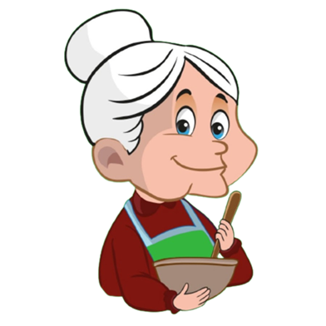
`
Dadi Ke Nukshe
PROJECT DEVELOPERS :
21CE074 : Faizan Momin
21CE081 : Nai Om
21CE082 : Disha Odedara
21CE084 : Kalp Pandya
GUIDED BY : Sneha Padhiar
U & PU PATEL DEPARTMENTOF COMPUTEE ENGINEERING

Slide 2
INDEX
Definition / motive of our project
main Goal
Info of project
Scope of project
Functional Requirements
GUI
2

Slide 3
1. Definition
3

Slide 4
Definition
Our main motto of this project is to give information to user about some homely cures of different illnesses like cold, fever, headache, migraine, throat irritation, stomach ache, etc.
Our information is based on home made cure (nuskhe) which generally given by our elders.
We also provide some basic information of illness causes and basic treatments.
Use can also suggest the home made cure (nuskhe) to us.
4

Slide 5
2. Main goals
5

Slide 6
Main Goal
Solve The Problem Of people by
using this Website to cure their illness.
Users can find information about natural herbs.
User can cure their selves in low cost.
User can now know our old culture how the rushimunis cure with natural herbs.
6

Slide 7
3. Information
7

Slide 8
Information
Home page / Section
Explore page / Section
Herbal Ingredient page / Section
Blog page / Section
About us / Section
8

Slide 9
Information
Home page / Section
where you can find some brief about this website and something that what our main motive is.
Explore page / Section
Where user can find the easy or we can say dadi ke nuskhe type cures through available home remedies.
9

Slide 10
Information
Explore page / Section
where user can find different type of herbal ingredients name and there use in cure.
Blog page / Section
Where user can find the effect or strength of that herbal ingredient which are used by different people, and their experience in covid-19.
10

Slide 11
Information
About us page / Section
where user can find the information about our team and other things.
11

Slide 12
Information : features of website
Information about different disease
Symptoms of different disease
Cure of disease as our dadi says
Knowledge about herbal ingredient
Herbal ingredient like tulsi, aswagandha, turmeric etc.
Some famous blogs of cure by herbals ingredient.
12

Slide 13
Information : more about project
This website will help user to cure their self at home
Because in the situation like pandemic people cant go outside.
And also the clinics are very crowdy.
In pandemic also doctors where charging more money for treatment
So in this type of scenario this website can help them to cure their self at home at very low cost.
13

Slide 14
All Information Gathered for website
https://github.com/om51203/sgp/blob/main/DOC-20220902-WA0001..docx
14

Slide 15
4. Scoop of website
15

Slide 16
Scope of our website
After pandemic all people are approaching towards “ayurvedic” cures so people will go on internet for finding details about herbal ingredient.
we are thinking for adding user feedback which make our website user flexible.
16

Slide 17
4. Functional Req.
17

Slide 18




Functional Req.
118

Slide 19
5. GUI
17

Slide 20
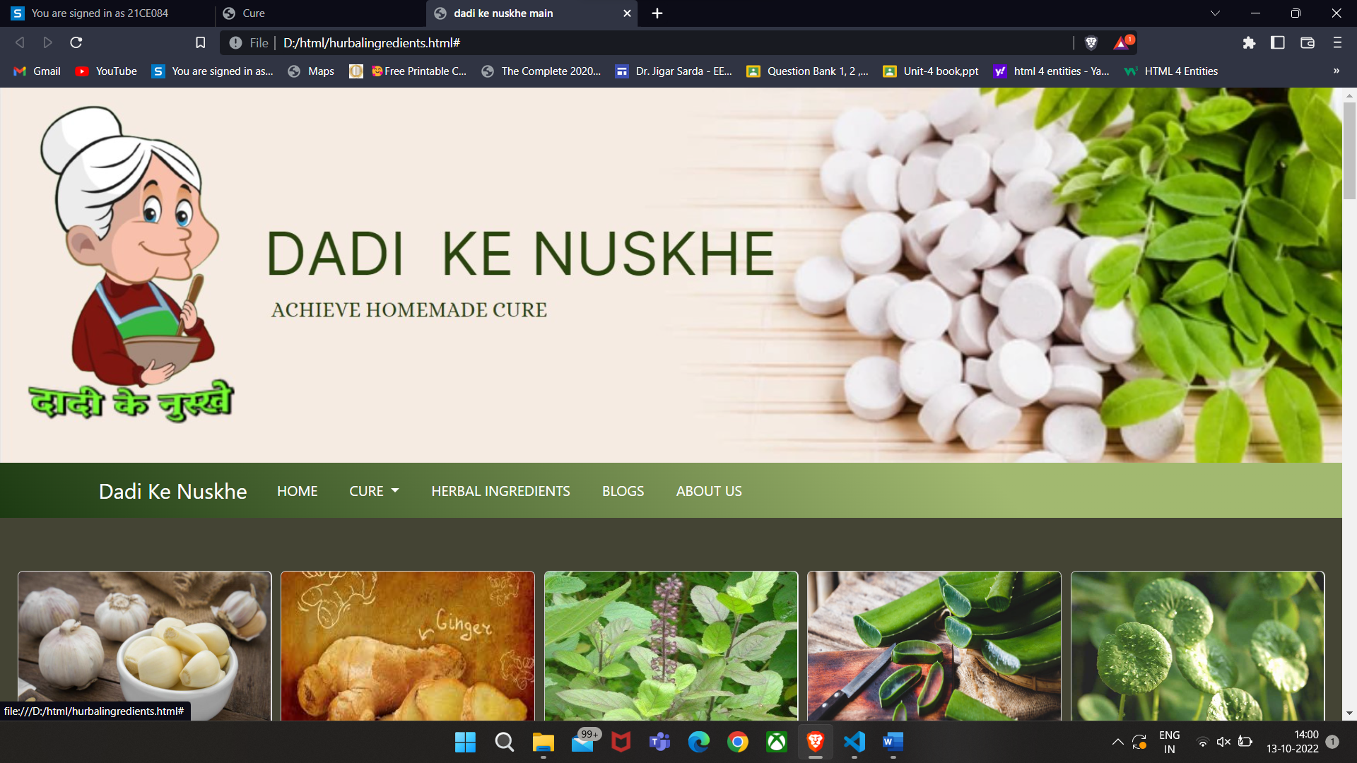
5. GUI
17

Slide 21


Thank You
17

